Slide 1
A View of Operating System Services
Operating System as a Resource Manager
Storage Management
Process Management
Memory Management
Extended Machine
Mastermind

Slide 2
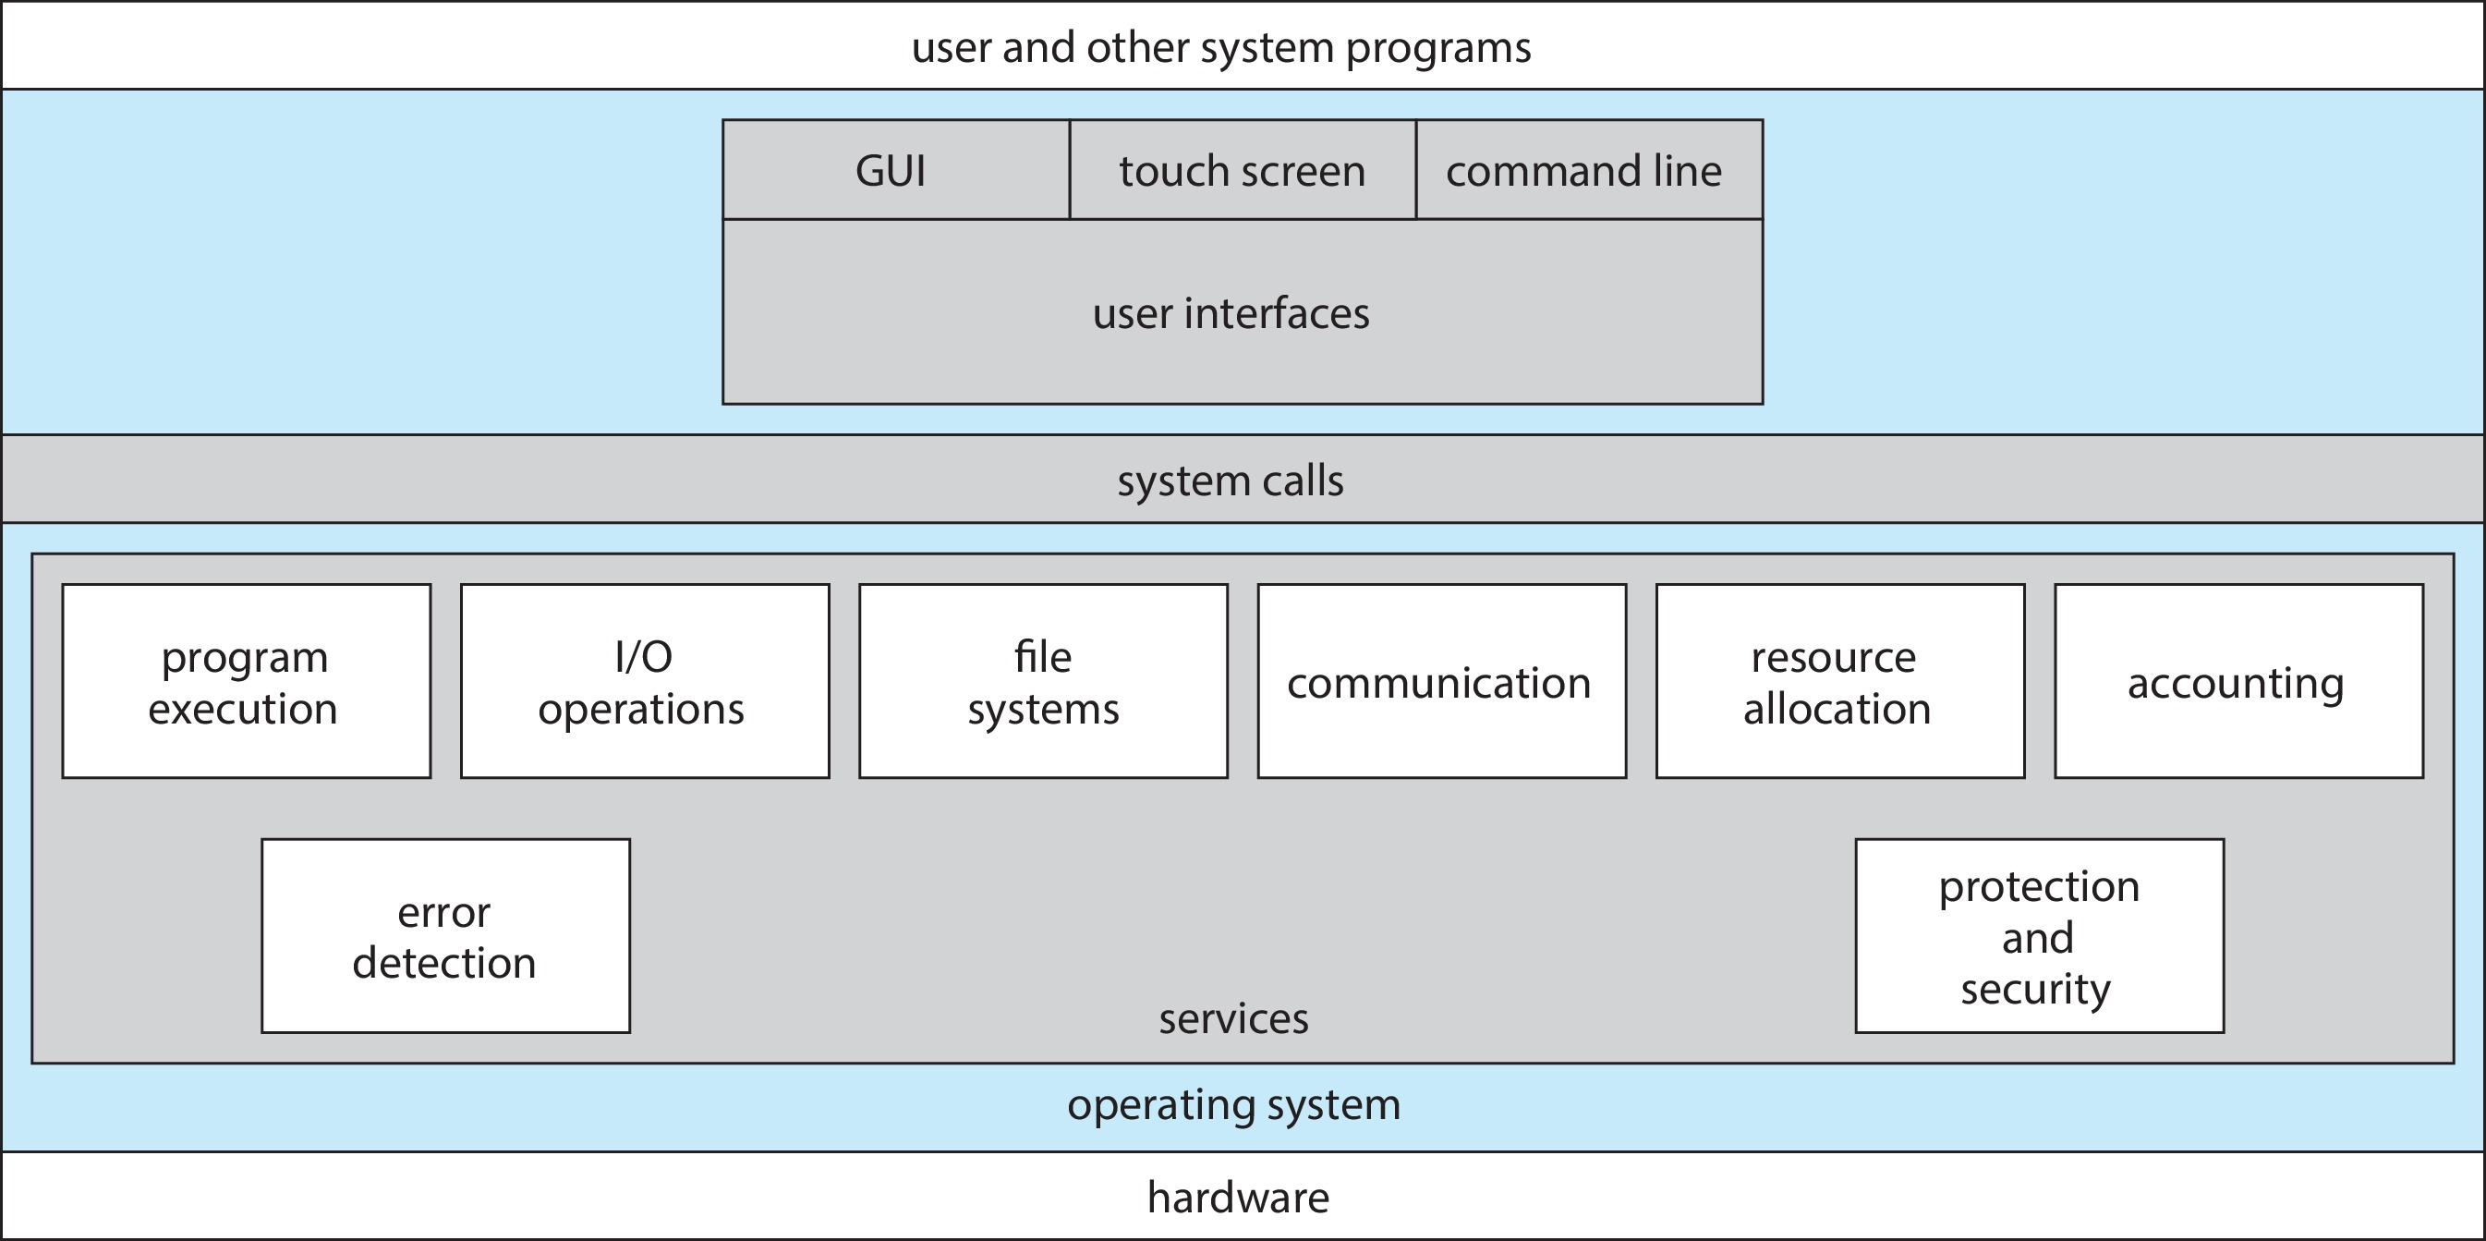
A View of Operating System Services

Slide 3
Operating System - Structures

Slide 4
Large & Complex
Carefully Engineered – Designed
Functions Properly & Modified Easily
Advantages & Disadvantages

Slide 5
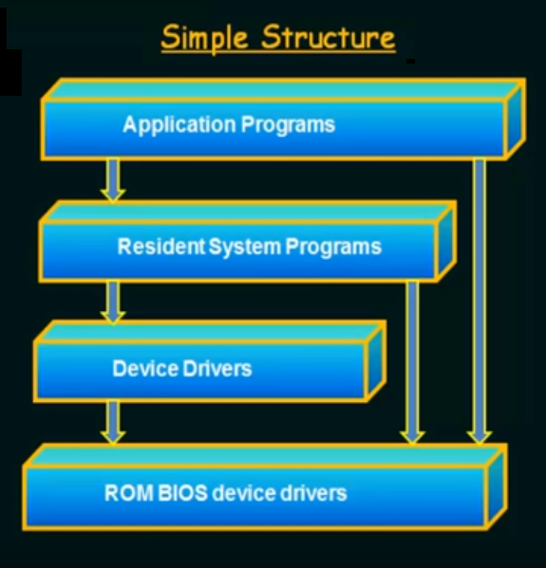
Beginning & Not fell defined.
MS DOS
Base hardware
Base hardware can be accessed by all the above to it.
Interfaces & Functionality are not well separated.
Program fails : Entire system crashes.
Not well protected.
Intel 8088 : No user / privileged modes

Slide 6
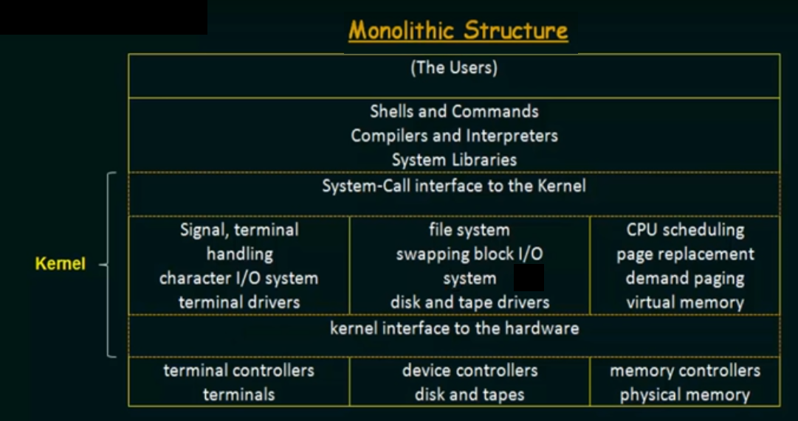
Earlier UNIX operating systems.
Kernel / System programs.
System call interface to the Kernel / Kernel interface to the hardware.
Kernel functionalities / Packed into ONE layer / Monolithic.
Implementation & Maintenance is difficult.

Slide 7
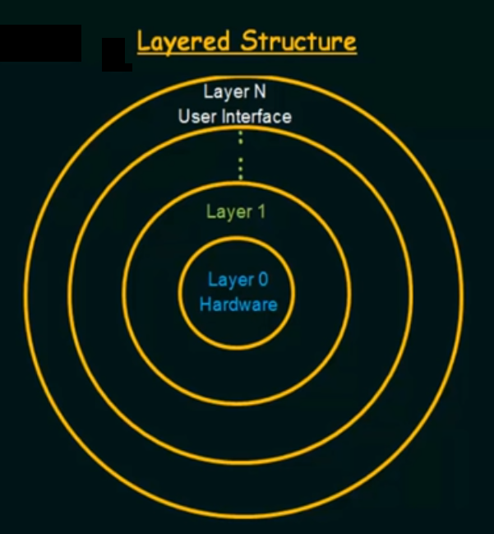
OS divided into number of layers.
Layer 0 : Hardware.
Layer N : User Interface.
Broken down the functionalities into separate layers.
Easy to implement & Debug.
Difficulty in designing, need to be very careful.
Layers arrangement / Above / Below.

Slide 8
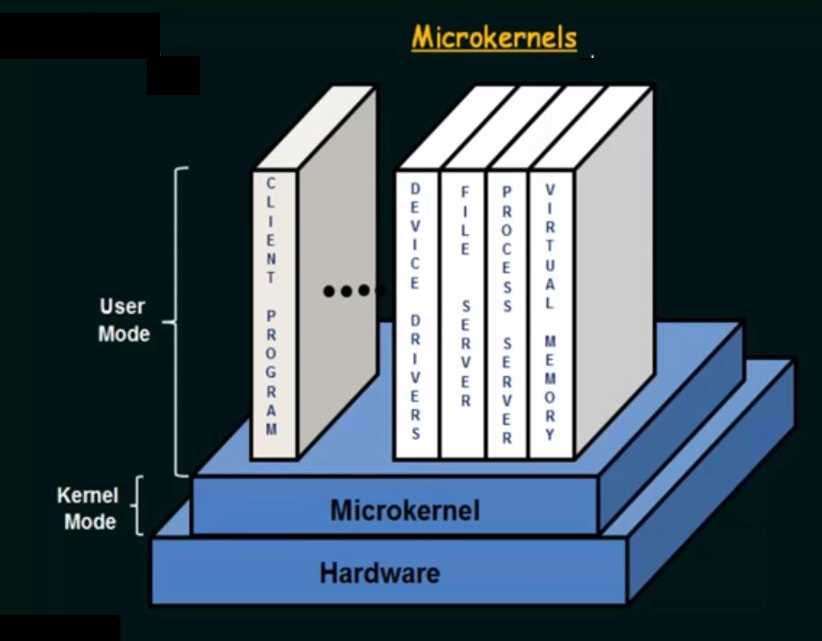
Micro Kernels / Remove all the non-essential components / System & User level programs.
Micro Kernel : Only core functionalities.
System programs on top of micro Kernels.
Communication between client programs & services.
Message passing.
Performance decrease due to system function overhead.

Slide 9
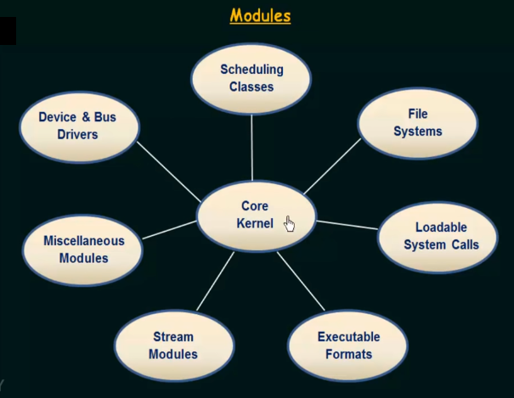
Core kernel / Other functionalities present in form of modules.
Modules are loaded dynamically, as and when required.
Looks like Layered & Micro kernel approach.

Slide 10
Hybrid Systems

